Slide 1
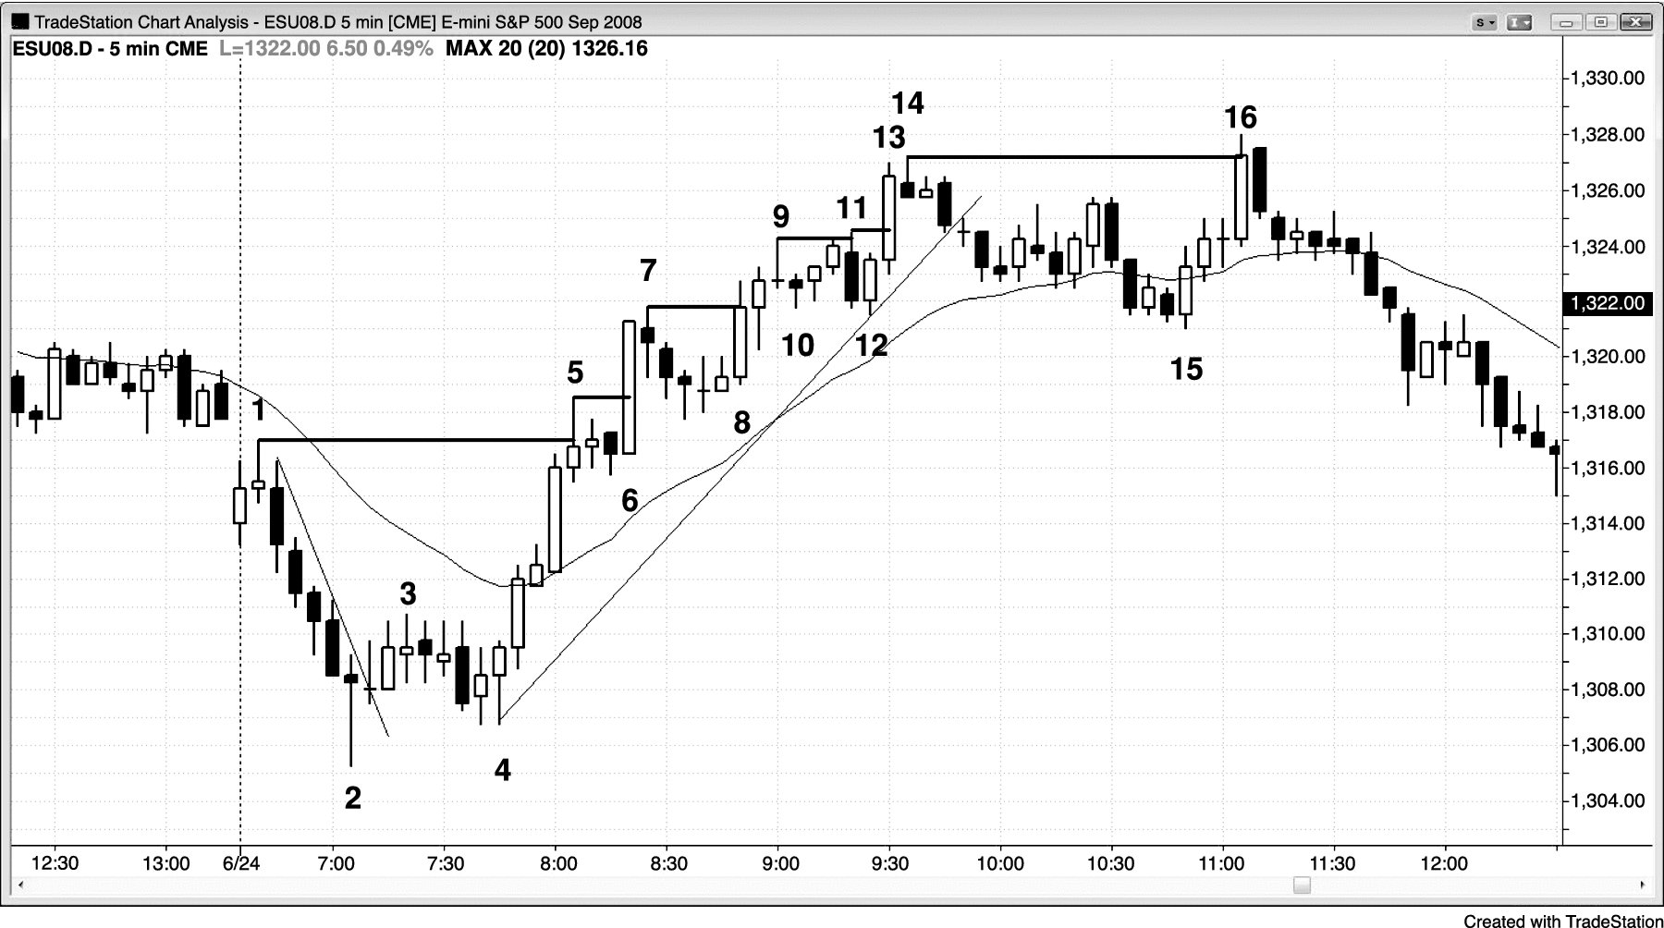
FIGURE 4.1 Strong Breakouts Have Many Consecutive Strong Trend Bars

Slide 2
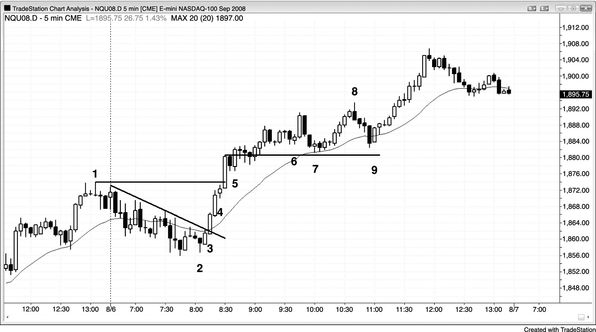
FIGURE 4.2 A Strong Trend Usually Has Follow-Through on the Next Day

